Slide 1
Style Transfer
MTA Learning From Examples

Slide 2
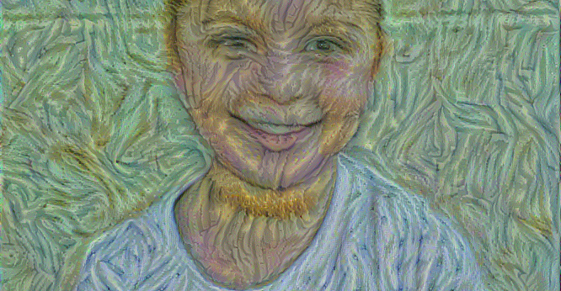

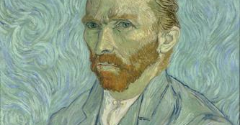
Example 1
Maayan
Van Gogh
Created 2015
Child and hell raiser
Note the giger beard
Created 1889
Portrait

Slide 3
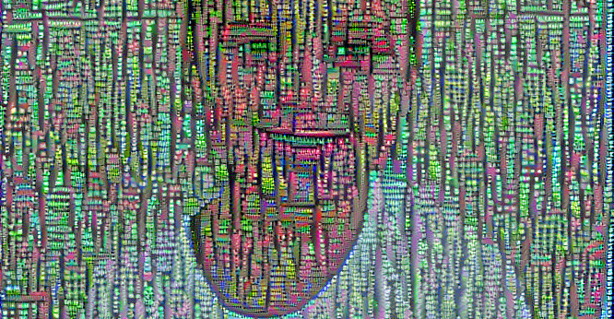
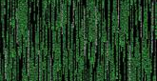
Example 2
Maayan
The Matrix
Created 2015
The chosen one
Created 1999
Movie Trilogy, and sex change incentive

Slide 4
Example 2 – Color Filter
Maayan
The Matrix
Created 2015
She has a spoon
Created 1999
Movie Trilogy, and sex change incentive

Slide 5
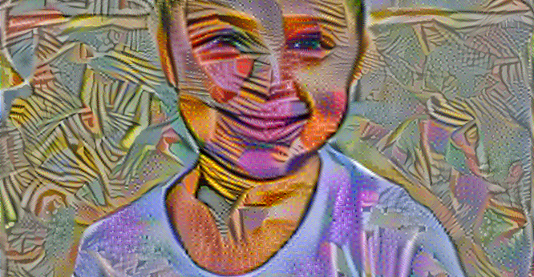
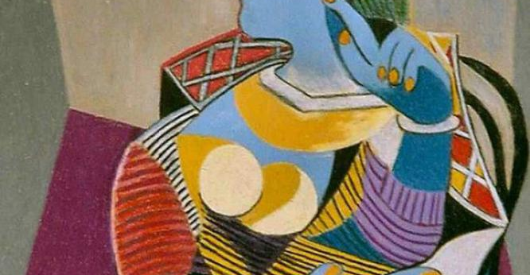
Example 3
Maayan
Picasso
Created 2015
Child and hell raiser
Created 1937
Seated Woman

Slide 6
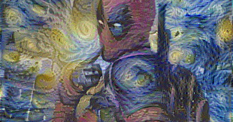
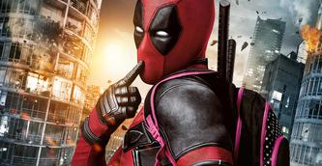
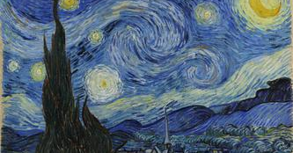
Example 4
Deadpool
Van Gogh
His honey brings the boys to the yard
Created 1889
Starry night

